Slide 1
ST MICHAEL’S ROWING CLUB INFO NIGHT 2023
Notes:
Intro – SMD – Captain / Coach / member since ~ 1986
Why have briefing
- We give you info on the club, structures, finances, training etc.
- you tell us what needs improving, how to improve, and you help us improve
SMRC – Sporting Club c. 177 years old includes Cecil St. premises – formerly had table-tennis and snooker clubs there – now property is rented and provides some income for the club (as well as costs)
– formerly had lots of sports including hurling, soccer, cricket, boxing and even drama
Temperance Society
Rowing Club Est 1901 – clubhouse on Dock Road / moved to OCS 1940
One of the larger and most successful clubs – c. 57 Irish Championships
New Ambitions to drive on and match the best!!!
2 Olympians / 3 World Championship – Many others U23 / Junior Worlds and other international events

Slide 2
AGENDA
Club Organisation & Structure:
Communication
Finances
Rowing Structure/Training Programs/Regatta Plans
Safety / Child Welfare
Volunteerism
Questions & Answers

Slide 3
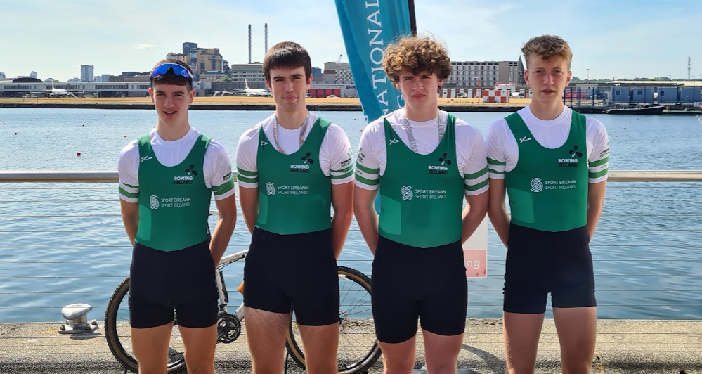
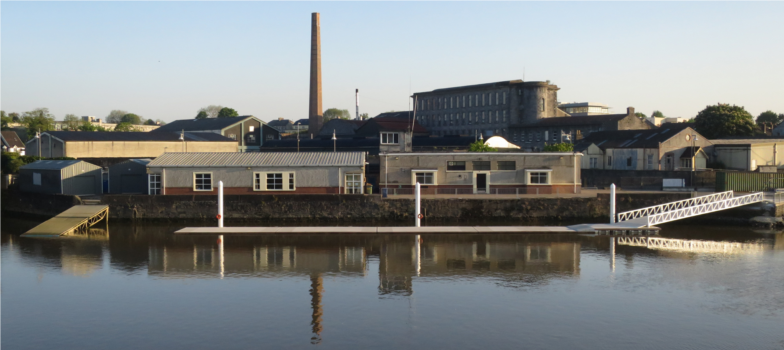
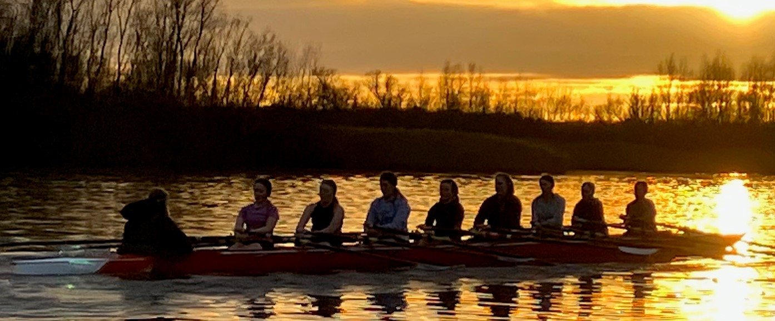
“OUR SUCCESS IS YOUR SUCCESS!”
2023 WAS AN EXCEPTIONAL YEAR THANKS TO THE LEADERSHIP & BEHIND THE SCENES WORK BY OUR COACHES

Slide 4
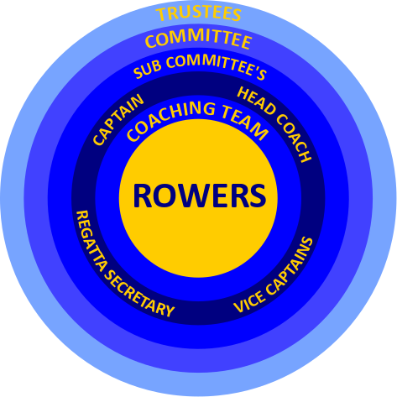
ST MICHAEL’S – OUR CORE STRUCTURE – ROWERS 1ST
Notes:
Voluntary Club – all volunteers / some minor paid support midweek and LTR
Rower centered – everything is done for the purpose of supporting our rowers
Priority of club is to produce elite competitive rowers / and other levels
Coaching Team – Pat Mc - Head Coach – RI dev coach – c. 8 or 9 lead coaches & further 15 or so helpers
Voluntary – c. 200 hours / week – SC – strategic review “equivalent to a small school”

Slide 5
St Michael's Rowing Club Organisational Chart 2022/23
Stuart McDonnell
Mike McDonagh
Eoin Kearney
Greta OByrne
Jams Ryan
Rowing Committeeinane Girls
Kate OBrien
Donal O’Byrne
Stuart McDonnell
Austin Leddin
Donal
Kate
Brian McInerney
Laura Kerr
Declan Hartnett
Andrew O’Connell
Declan Hartnett
Declan Hartnett (President)
Brian McInerney (Vice President)
Dara O’Connor(Hon Secretary)
Austin Leddin (Hon Treasurer)
Stuart McDonnell (Captain)
Kayla McCann
Elanor O’Connell
Pat McInerney
Adrian Cunningham
Eoin Kearney
The committee are making some changes to simplify the sub-committees
Fr. Des McAuliffe Fr. Michael Wall
Declan Hartnett Pierce McGann
www.smrc.ie

Slide 6
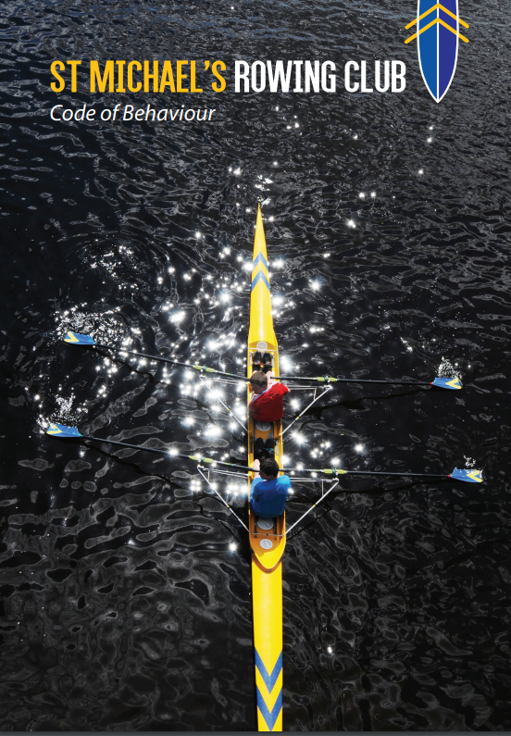
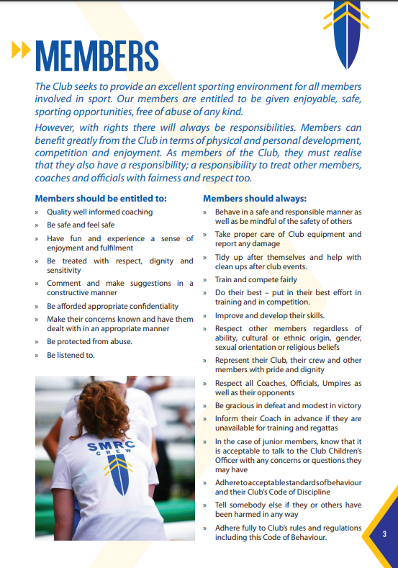
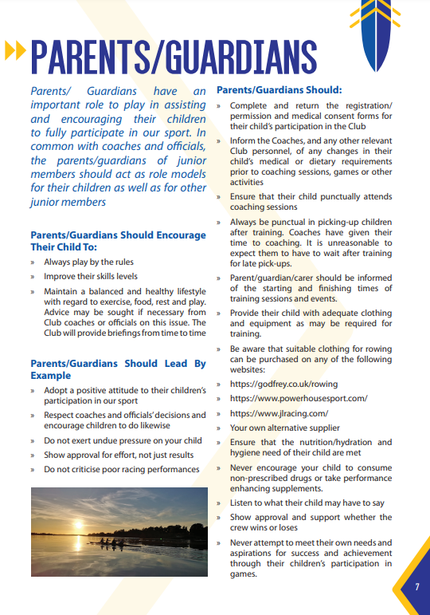
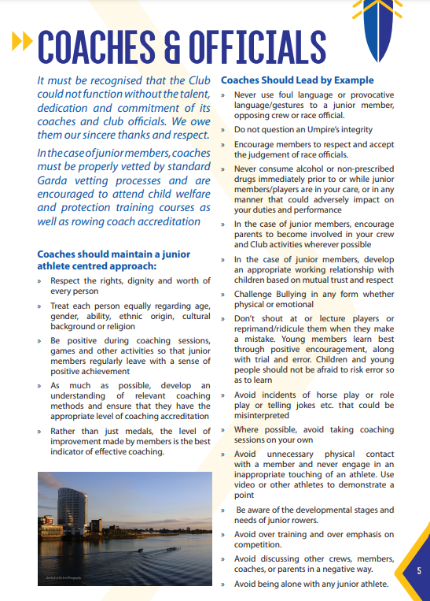
ST MICHAEL’S RC – CODE OF BEHAVIOUR
Code of behavior is available on the club’s website www.smrc.ie
Mission Statement & expected behavior & standards for all members, coaches, volunteers and parents are detailed
The club needs active & invested members in order to succeed

Slide 7
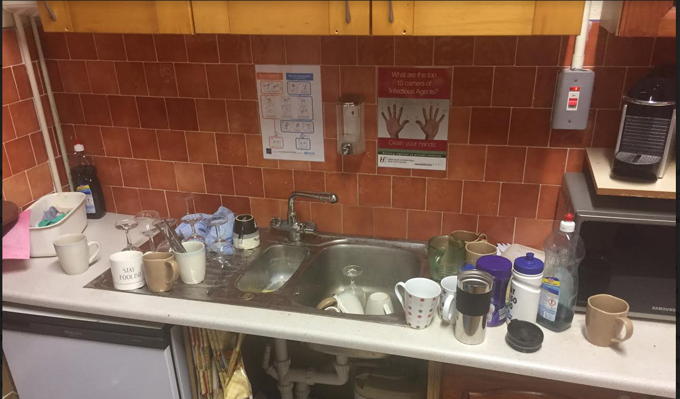
IT’S YOUR ROWING CLUB.
All members are expected to clean up after themselves and to help out with keeping the club clean. If it’s good enough for All Blacks then it’s good enough for us!
Quarterly clear out of the club.
Monthly Squad rota for regular cleaning of the dressing rooms(dressing rooms are not personal wardrobes)/kitchen/toilets.
Emptying of bins/correct use of recycling
EXCELLENCE IS A HABIT!

Slide 8
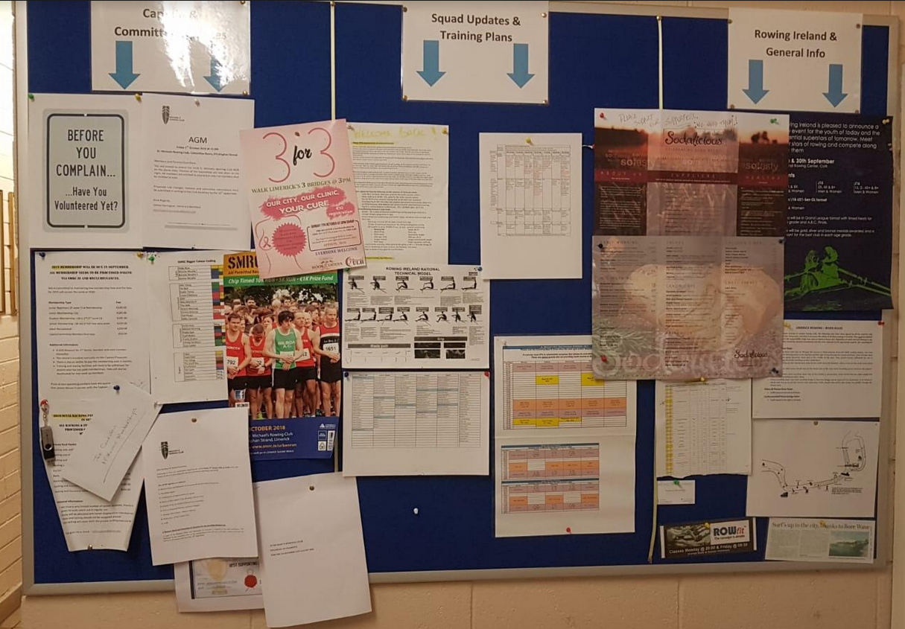
ST MICHAEL’S RC – COMMUNICATION CHANNELS
Notice Board:
Regular updates on planning, events, training plans, training times, regatta/HOR entries etc. are posted on a weekly basis.
We expect rowers, coaches and admins to check it regularly.
WhatsApp groups/Emails to Members Emails to Members
Social Media
Rowing Ireland - www.rowingIreland.ie
SMRC – www.smrc.ie
Clubforce

Slide 9
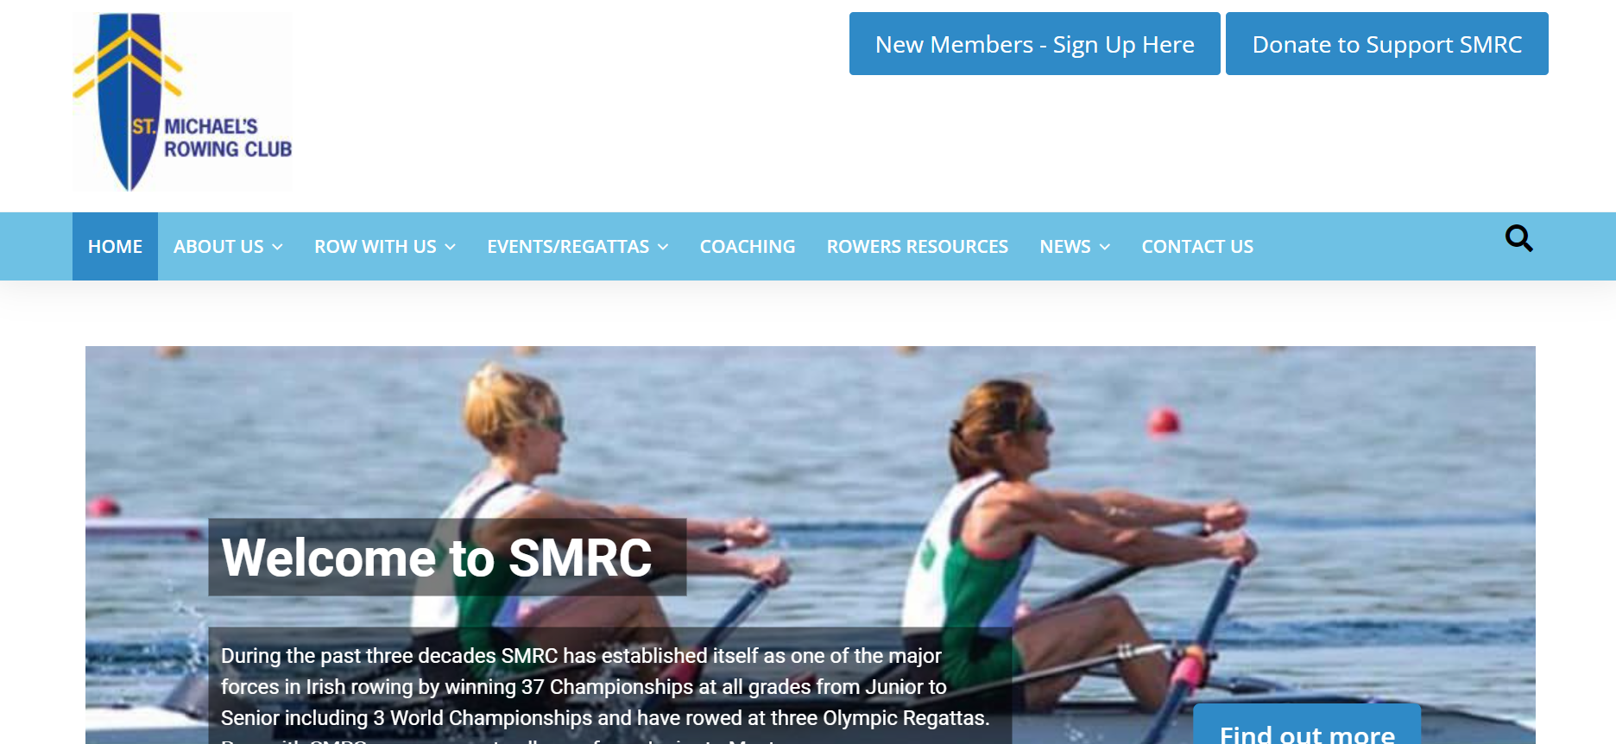
ST MICHAEL’S RC – EMAIL POINTS OF CONTACT
smrccaptain@gmail.com smrccoaching@gmail.com
smrcpresident@gmail.com stmichaelsrcsecretary@gmail.com
smrctreasurer@gmail.com smrcevents0@gmail.com
SMRCCPO@gmail.com
Please refer to the club’s website for contact details, club rules, code of behaviour etc.

Slide 10
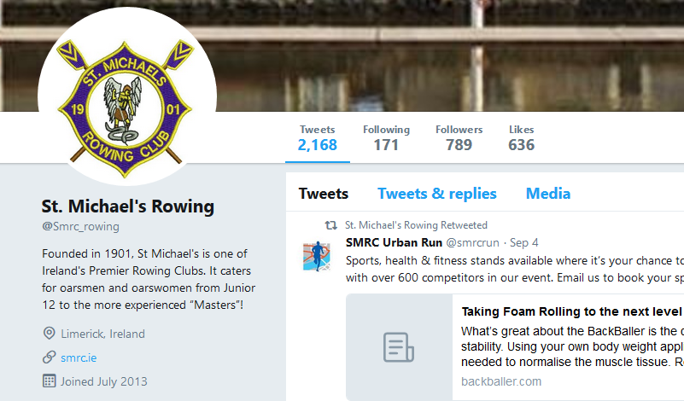
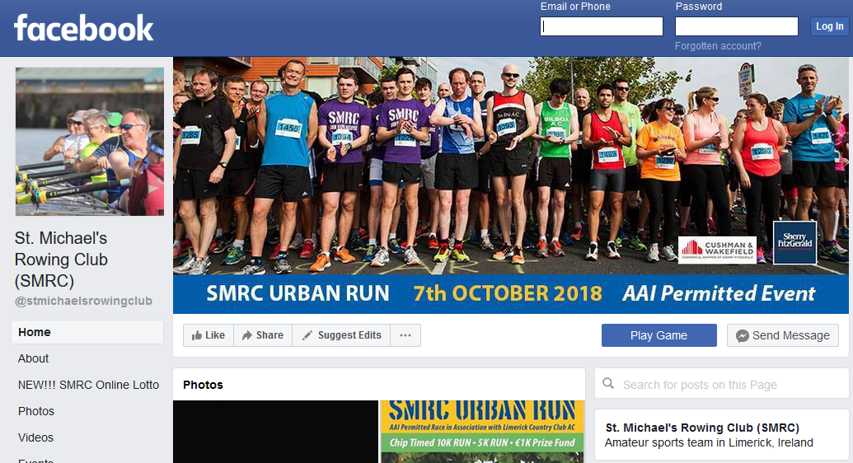
ST MICHAEL’S RC – SOCIAL MEDIA
Website www.smrc.ie
Twitter @smrc_rowing
Facebook www.facebook.com/stmichaelsrowingclub/
Instagram stmichaelsrowingclub
Like & share our post to help increase coverage & support.

Slide 11
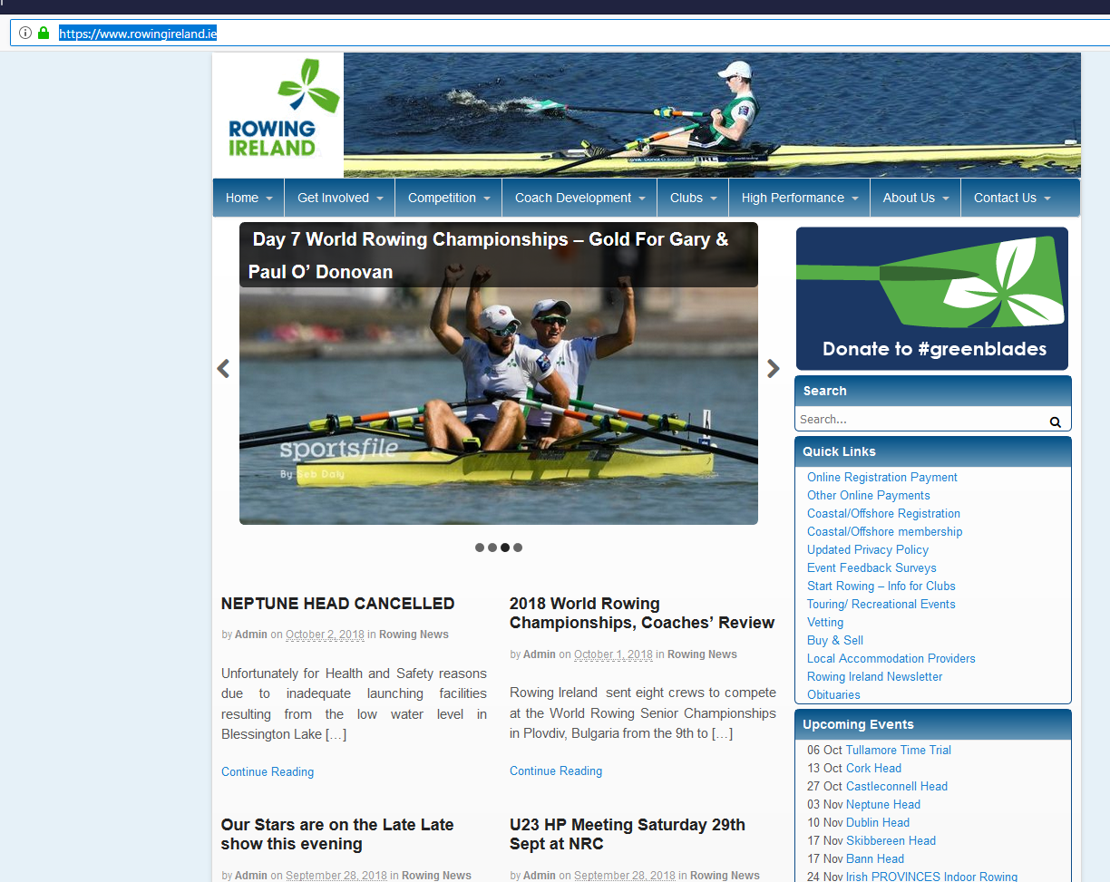
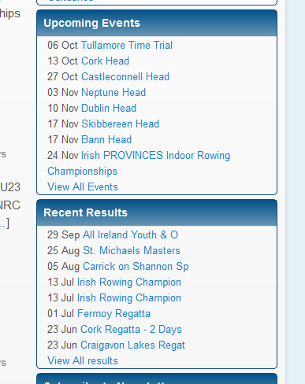
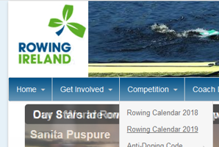
ROWING IRELAND
Rowing Ireland has a very comprehensive website which contains a huge amount of information on the sport, it’s
administration and the events which we attend.
Sign up for the weekly RI email newsletter
www.rowingireland.ie/
Take some time to familiarise yourself with the website;
HOR & Regatta Calendars for 2019 Season
Individual links to each event taking place
Timetables
Draws
Accommodation/Parking

Slide 12
CLUBFORCE APP
https://clubforce.com/clubs/community-st-michael-s-rowing-club-smrc-limerick/
- Membership
- Regatta / HOR Levies
- Weekly Lotto
- Event Tickets (Dinner Dance)
- Coming Soon – Split the Pot Fundraisers!

Slide 13
FINANCES - APPROXIMATE RUNNING COSTS / INCOME AND FUNDRAISING
Our budget for 2023/24 is revenue based of €150,000 of which appoximatley one third is membership fees, one third is rental income and one third is fundraising.
Opperating expenses account for 80% of our budget before any capital expenditure on boats, equipment and facilities
Therefore fundraising is a must!
And that’s before we buy any new equipment or any other major investments.

Slide 14
FUNDRAISING
We have an ambitious investment plans under several headings:
Cecil Street (necessary building repairs & upgrades)
Boat upgrade plan
New boats for top level crews
Replacing the older fleet, some boats going since the 90’s!
Athlete Support - we had 13 athletes represent Ireland 2023.
Coach Development – parents are welcome to join & Rowing Ireland certified training is available.
International Regattas - Ghent, UK Schools, Henley and HOC.
Transport – Trailers and Buses
Club needs to fundraise over 40k per annum to support plans

Slide 15
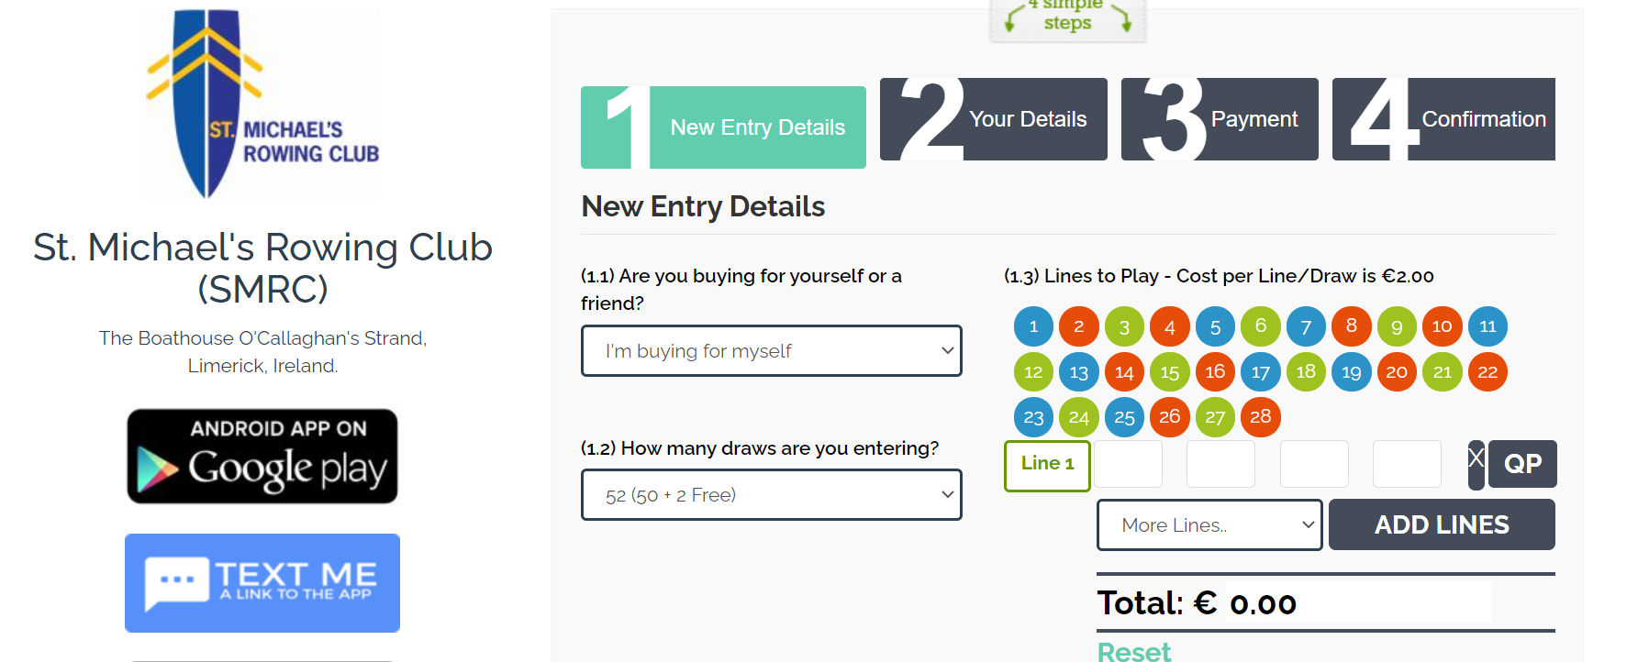
FUNDRAISING ACTIVITIES
Lotto
Recent & Planned Fundraising:
Victory Dance – Oct 2023
Art Auction – TBA
SMRC OBB HOR Sept 2023 Success
Table Quiz – Sept 2024
Row-a-thon – 13th Jan 2024
Table Quiz (Parents) – Feb 2024
SMRC HOR – Feb 2024
Traffic Buckets – 2024
Corporate Rowing - 2024
Sponsorship signs - 2024
“2024 has started well with over €10,000 raised through corporate event!”

Slide 16
RECENT SPENDS
ON GOING COSTS
Decentrowing.com – 350/ year
Small Trailer - €5k
New Oars - €4k
Insurance ~ 20K per year
Legal costs
LTR / S&C support
Fleet repair
Facilities management
Toilets OBB
Consumables
FUTURE SPENDS
Mid Weight 4x+ 2024
Upgrade program for 2x & 1x
Development of SMRC

Slide 17
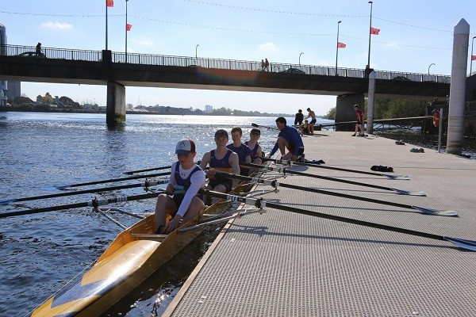
CORPORATE SPONSORSHIP
Corporate Sponsorship is the quickest way for club to achieve its fundraising goals
Opportunity for long term partnership
What will business get?
Company Participation Activities
Spring corporate rowing programme
Winter Ergometer indoor programme
Company Sponsorship Opportunities
SMRC Head of the River in O’BB and locally and Masters Regatta
Company Branding Opportunities
Advertising boards x 2 – high footfall areas
Branding on trailer, boat, website, newsletter, social, etc.
We need DECISION MAKERS or the ear of DECISION MAKERS

Slide 18
SQUAD STRUCTURES
‘Swim lane’ system / train by ability
Div 1 – Senior, Intermediate, J18
Div 2 – J18 B, J16
Academy / Junior Club – 1&2 – J16, J15, J14
Learn To Row – beginners
Recreational Rowers Group
“Different ability & events!”

Slide 19
ROWING STRUCTURE
Intro to Rowing Camps – run for beginners in Summer / Easter breaks etc.
Learn To Row (LTR) program – run for c. 10 weeks – kids get introduced to rowing and midweek ‘land training’. After this some will progress to Year 1 group, and some will continue in next LTR program. Get to race at Home events.
Year 1 Club Juniors / Academy – Rowing and training is pushed on a little including an extra midweek training day and increased weekend mileage. This group will get to go and race at local / provincial events
Div 2 More experiences rowers – usually train at least 6 sessions per week – depending on ability will race local and national events – may race British Schools event
Div 1 Junior 18 A / Senior level – National and international events / Irish Trials

Slide 20
ST MICHAEL’S RC – HERE’S THE SMRC LINE
“We need and expect everyone (coaches, committee, rowers, parents)
to have confidence in the club and to trust the club in what we are doing.”
It’s the coaches, led by the rowing committee, who decide on training plans & schedules, competitive events, the fitness tests/seat racing process & ultimately crew selection.
Rowing is a highly competitive sport and from season to season there will be disappointments. Everyone is given a fair chance to excel in the sport but not everyone will. We prepare the crews for failure as well as success, this is all part of competing.
Any questions you or the rowers may have with regard to training or crew selection can be dealt with in person with the head coach, coaches and captain.
“We are inclusive to Girls and Boys of every level and ability!”
New rowers – learn about the sport and get fit during the summer camps and the trial period but… we have very limited spaces available.
We expect the time & effort commitment our coaching volunteers give is reciprocated by attendance & effort.

Slide 21
TRAINING (SAMPLE PROGRAM)

Slide 22
ATHLETE GOALS & OBJECTIVES
Club aim is to produce top level rowers – winning national championships and gaining international recognition
Excellence / Winning culture – balanced with integrity and respect
Honesty & Transparency in testing, assessment and selection
Keeping it fun / rower enjoying sport & fulfilling ambitions
Right First Time:
Training Diary Water Bottles and fuel
Appropriate Gear Rest & Nutrition
Time Keeping Respect for each other
Active membership – kids get involved, clean the club, take ownership

Slide 23
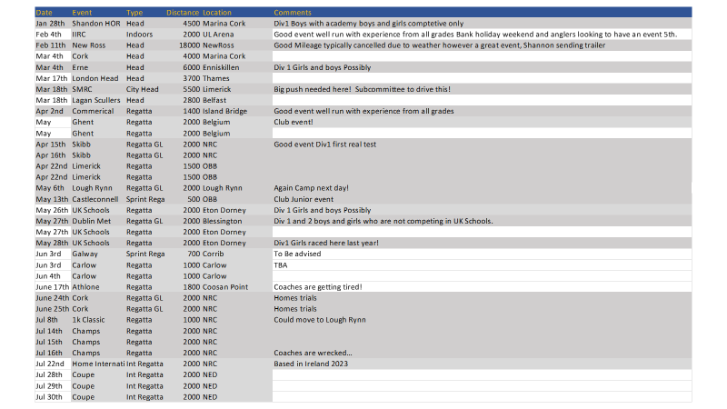
REGATTA / HOR SCHEDULE

Slide 24
SAFETY / CHILD WELFARE
Junior boats must be accompanied by safety launch at all times
Launches equipped as per RI – throw line / thermal blankets / whistle / knife / first aid box
Life jackets for coxes and all in launch
Capsizes happen – drills / swim tests
Club & OBB have AED
First Aid and AED at club and OBB
No gym work on own
No nonmembers training permitted
Radio communications
Safety statement / Risk assessment in place / audits conducted
Child Welfare Officers:
Kate OBrien
Donal O’Byrne
Garda Vetting in place
2 Adults rule when training juniors
Social Media
Code of Behaviour

Slide 25
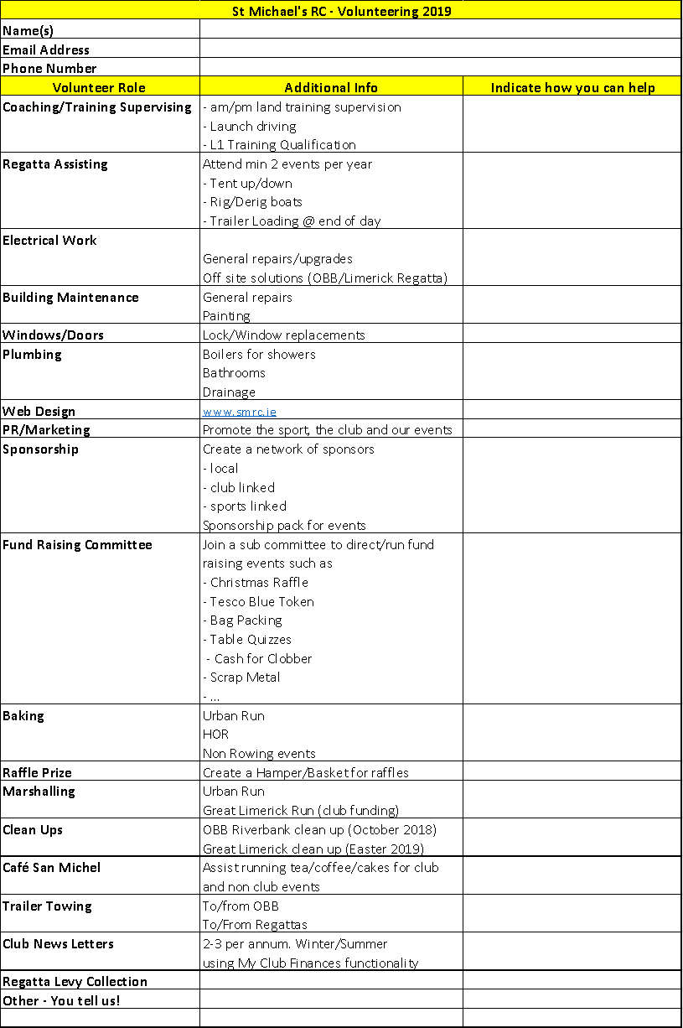
VOLUNTEERISM IN ST MICHAEL’S
– GET INVOLVED
As you can see it’s the same 20 people who coach, administer, fund raise, transport, update social media, take pictures, promote the sport, apply for grants and keep the club going.
We need help! We need your help!
It doesn’t have to be a huge amount of time or effort. If everyone takes on one task then the workloads gets much more manageable.
Benefits include:
Give back to the club.
You help secure the future of the club.
You’ll learn more about the sport and the club’s functions.
Feel good factor from a job well done.

Slide 26
Thank You All for giving us this time!

